Slide 1
The mesosphere & thermosphere
David Jackson
david.jackson@metoffice.gov.uk
Space Weather Research, Met Office
Thanks to past lecturers for content:
Edmund Henley (Met Office)
Anasuya Aruliah (UCL)
Ingo Muller-Wodarg (Imperial)
Nick Mitchell (ex-Bath)
Alan Aylward (UCL)
STFC Introductory Course in Solar & Solar-terrestrial Physics
St Andrews University, 24 August 2023
3
Notes:
This area uses many areas you may have covered in your physics undergraduate learning:
Electricity & magnetism
Waves
Dynamics
Thermodynamics
Optics
Quantum physics
Chemistry

Slide 2
Structure of lecture
Thermal structure: energy sources and sinks
Dynamics: wind structure, momentum balance and waves
Observations and modelling

Slide 3



The “Ignorosphere”: ~100-300 km altitude
Neutral atmosphere: remote sensing hard
In situ measurements possible with low-altitude satellites above
Gap!
Some remote sensing, but
Sounding rockets (~120 km), radar (~100 km) & weather balloons and satellites (~30-50 km) can measure below
Height dependence of atmospheric temperature and density according to the NRLMSISE-00 model (Doornbos, 2011)
Notes:
Above are 2 plots of the height dependence of atmospheric temperature on the left and density on the right according to the NRLMSISE-00 model (Doornbos, 2011).
The region 100-300 km is too high for rockets and too low for satellites and consequently poorly measured.
It is a critical region that couples the effects of Space Weather from above to the meteorological weather system underneath.
An indication of the problem is the set of 5 models simulations of the global temperature at 120km altitude shown below.
The JB2006 model is a semi-empirical global model used for satellite orbit prediction; and is highly simplified in the ignorosphere altitude range. This may be acceptable for satellites, but not for tracking space debris.
Emmert et al. (2004) solar radiation pressure ~ atmospheric drag above ~800 km (solar max) and ~ 500 km (solar min)

Slide 4
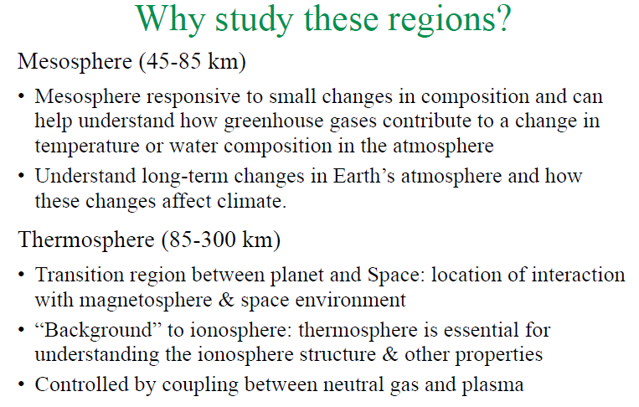
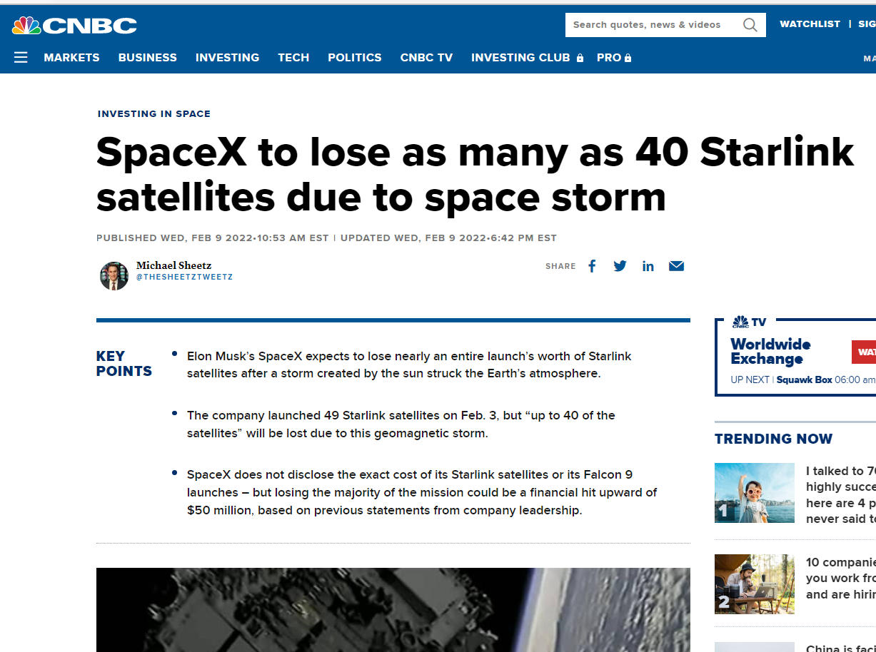

Space Weather Impacts
Changes in EUV (enhanced over ~days or short term (solar flares)) can change thermospheric density by ~20-200%
Severe geomagnetic storms can change density by up to ~700%
Changes satellite drag – hard to track satellites or debris and enhances collision risk
Sometimes storms don’t need to be that big – Starlink event
Notes:
NB sliver of atmosphere surrounds Earth – Re = 6370 km
500 km atmosphere layer ~ 8% Re
300 km atmosphere layer ~ 5% Re

Slide 5
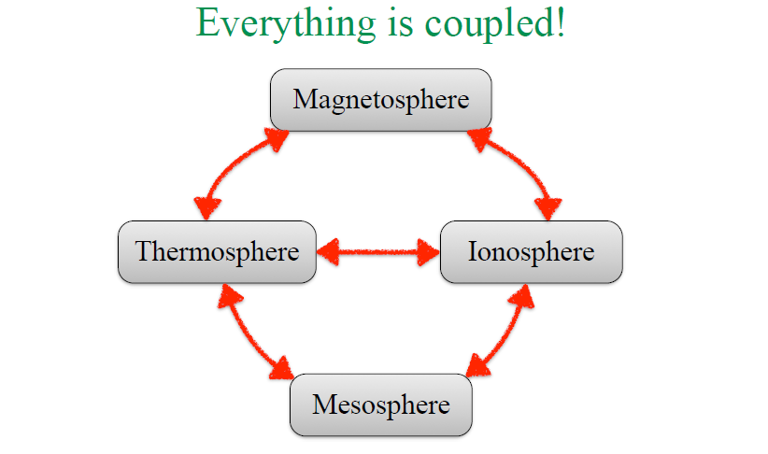
Sun
Solar wind

Slide 6
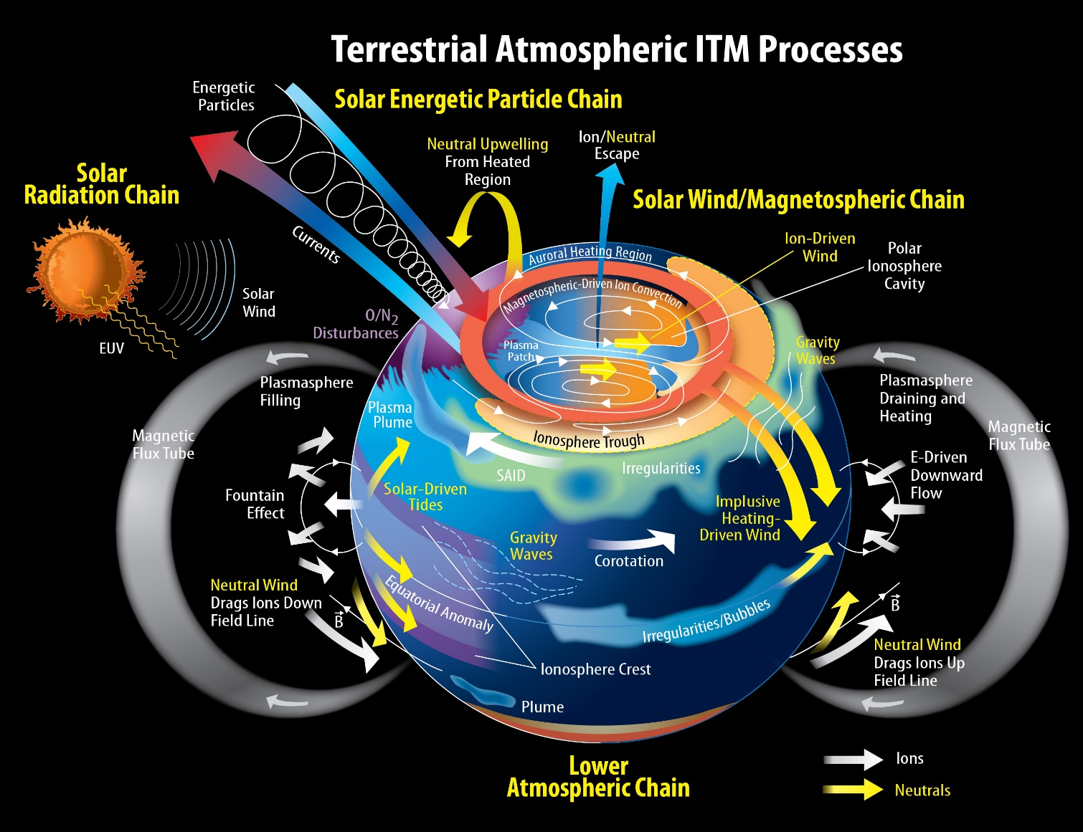
Big picture
Everything is coupled!
Outward to the solar wind and sun
Downward to the lower atmosphere
Between ITM spheres
Internal variability!
So very complex
Lots of interacting processes…
J. Grobowsky / NASA GSFC
Notes:
https://doi.org/10.17226/13060

Slide 7
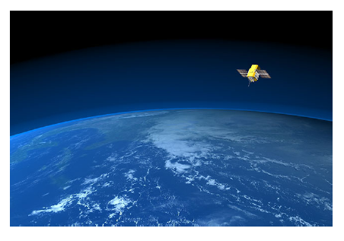
Part 1: Thermal structure, energetics

Slide 8
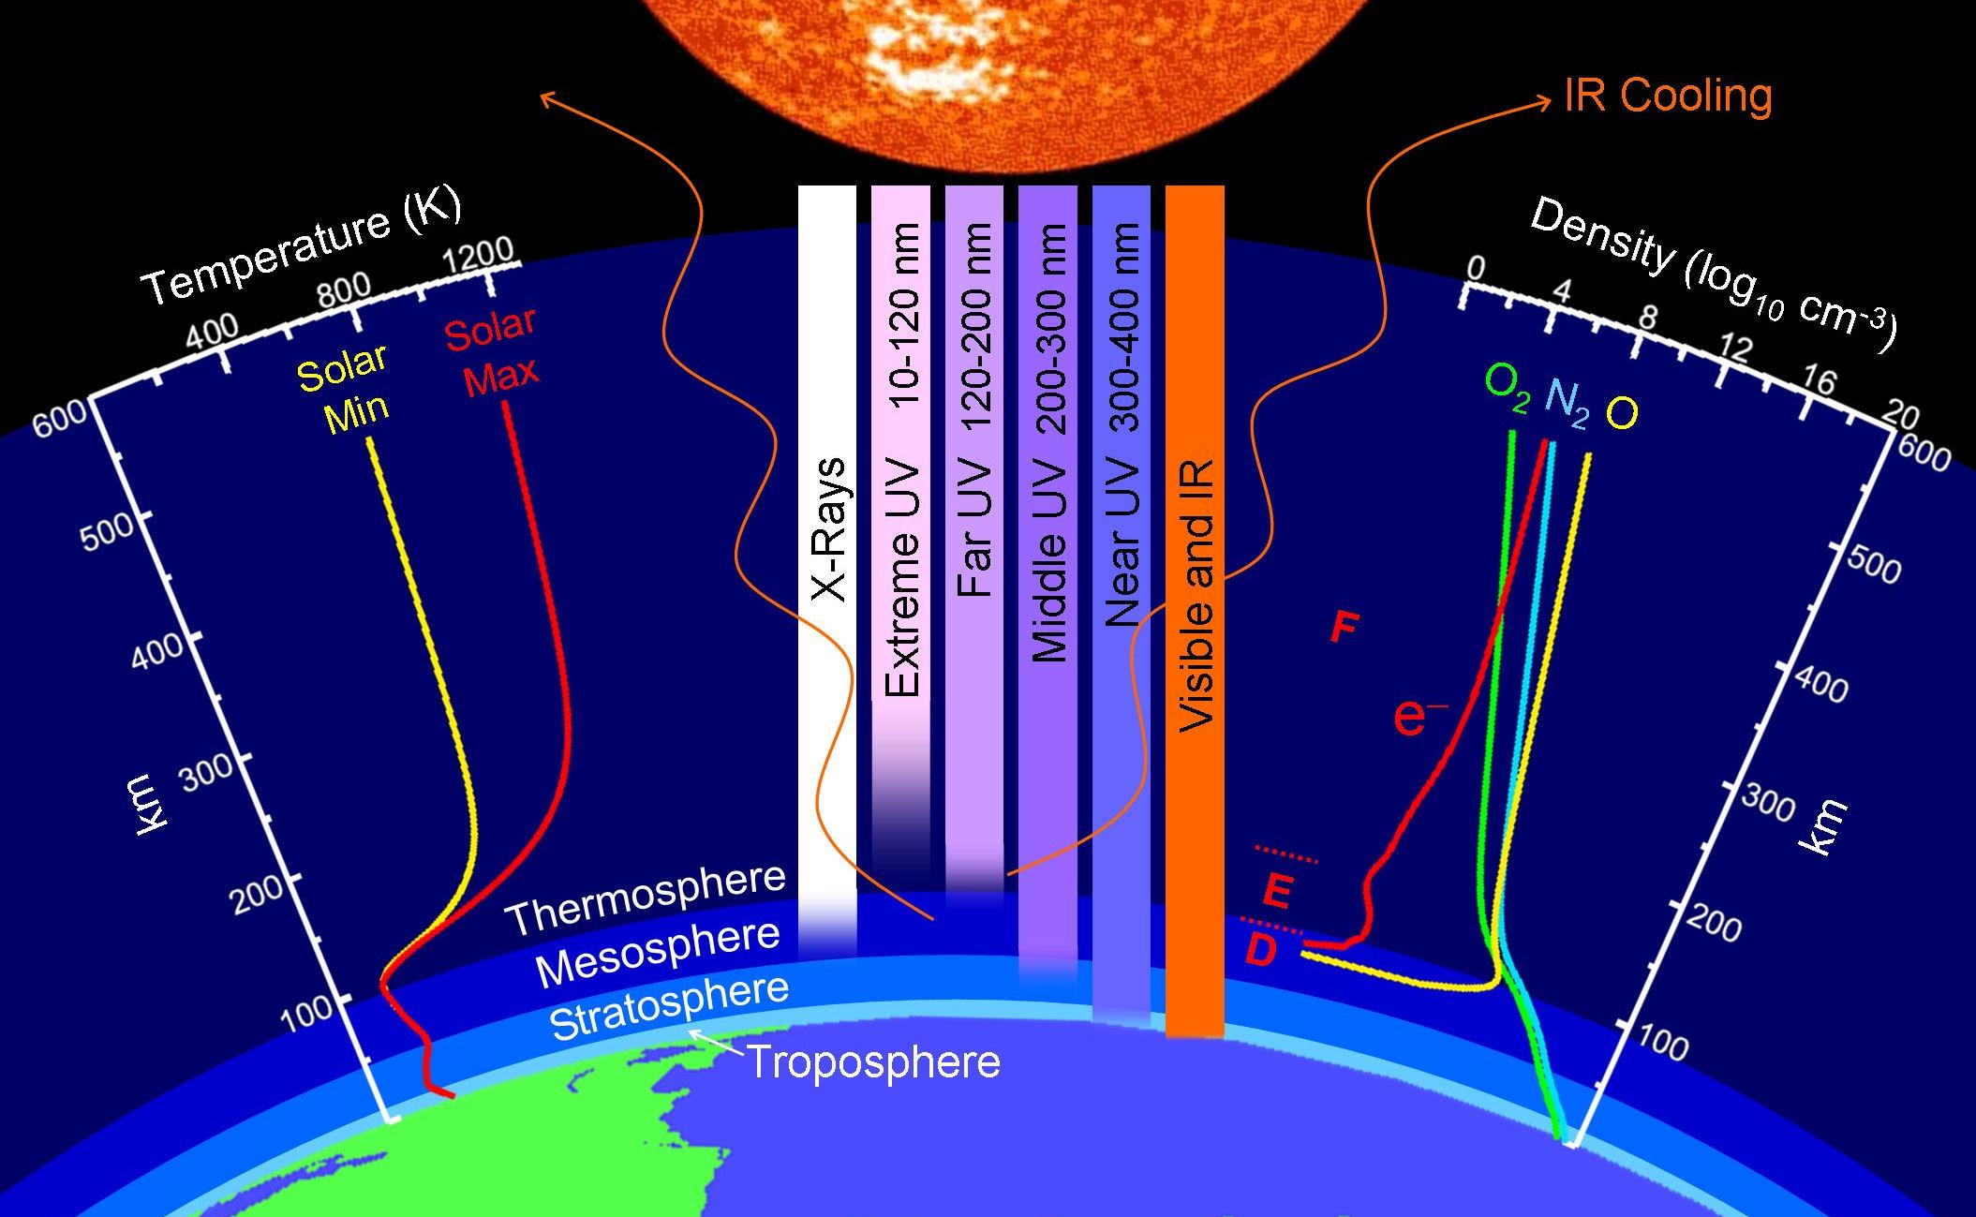
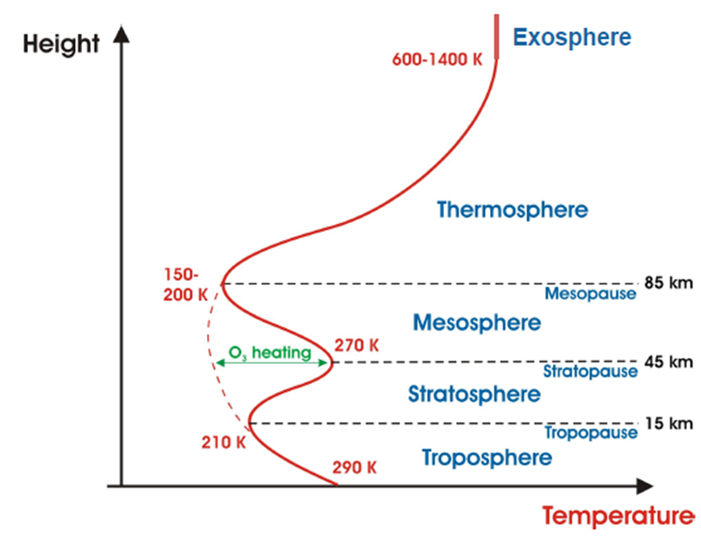


Spheres & pauses: temperature
Gradients arise due to heating and cooling processes
Radiation a key process
Different wavelengths involved at different heights
Spheres’ composition a key factor in radiation budget → temperature profile
NEmmert/NRL
Notes:
This graphic depicts Earth's upper atmosphere. It shows at the bottom a partial Earth globe with the Troposphere, Stratosphere, Mesosphere, Thermosphere layers labeled rising above, the temperature difference as you increase in altitude from Earth for both solar minimum and solar maximum periods, the atmospheric penetration of the various spectral wavelengths entering the atmospheric system, the density of oxygen, nitrogen and carbon dioxide as you increase in altitude from the Earth, and the approximate height within the ionosphere of the D, E and F levels. Above all this is a partial Sun globe. Credit: John Emmert/Naval Research Lab

Slide 9
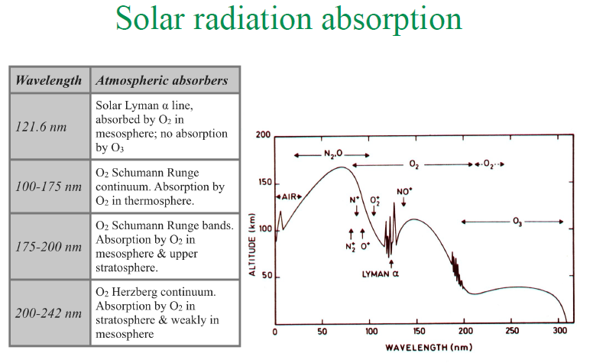
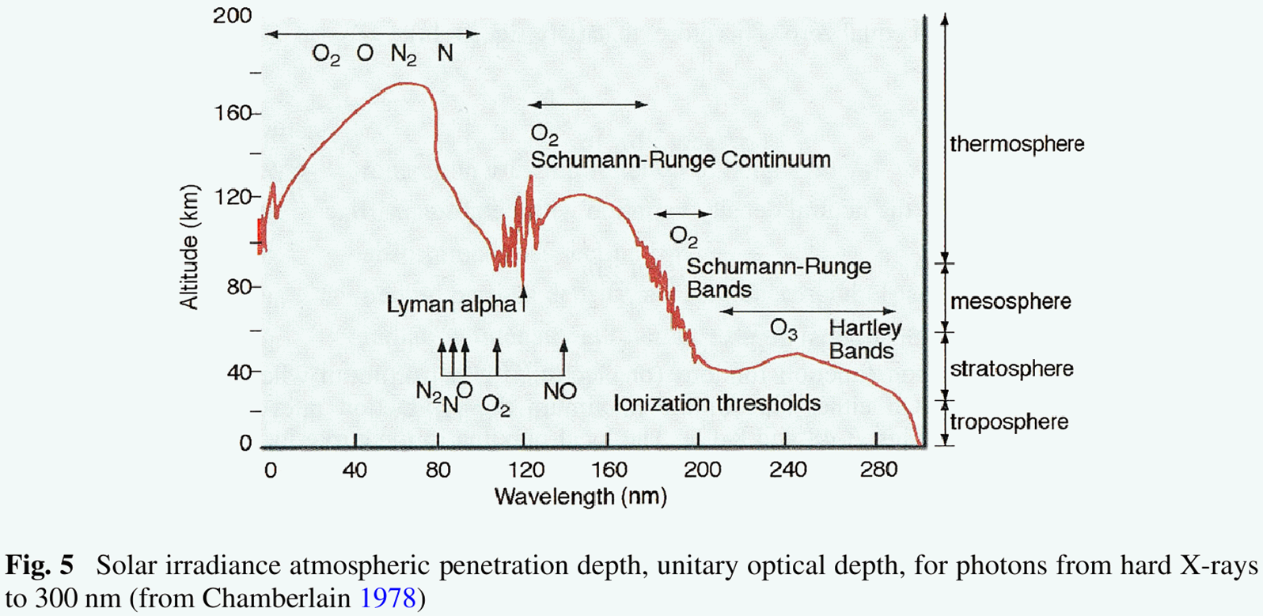
Notes:
Energy from solar photons: EUV is around 10-122 nm; FUV is around 122-200 nm

Slide 10
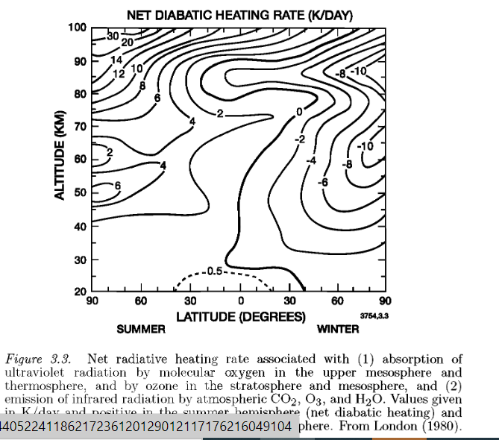
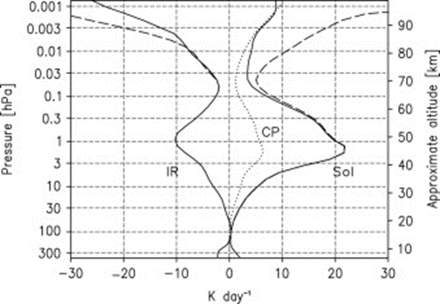
Middle atmosphere radiative heating
O3 heating maximises near 50 km – this creates the stratopause
IR cooling (mainly due to CO2) leads to net heating (cooling) in summer (winter)
So highest (lowest) temperatures in extratropical summer (winter) stratosphere and mesosphere, right?

Slide 11
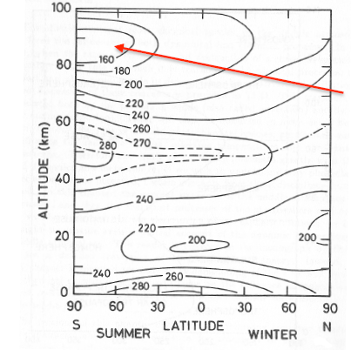
Middle atmosphere temperature structure
Yes, for the stratosphere
But no for the mesosphere – Note the cold summer mesopause region!
This is caused by the impact of breaking gravity waves (wind deceleration and adiabatic cooling) – see later
It shows that coupling between radiative heating and dynamics is very important
Notes:
What does adiabatic mean?
dU = dW + dQ
Adiabatic means no heat nor mass transfer i.e. dU = dW = pdV

Slide 12
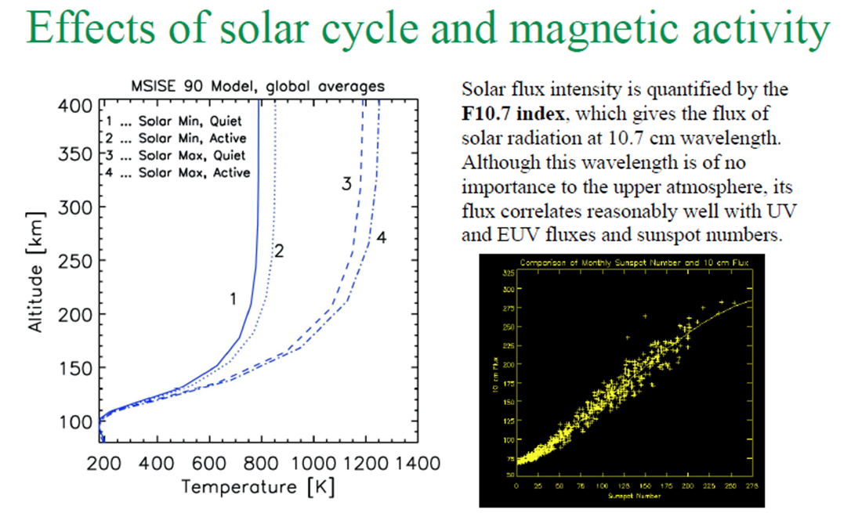
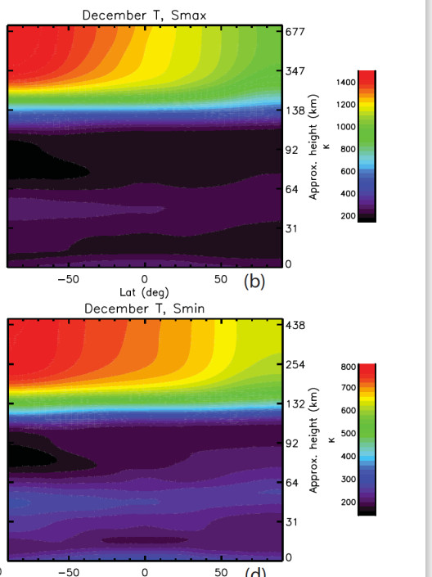
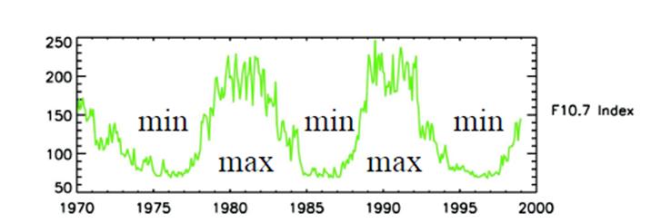
Thermosphere temperature structure
Similar plot but extended to > 400 km
Structure switches back to warm summer / colder winter above around 100 km – radiative effects more dominant than below
Also other variations due to solar input – diurnal cycle and solar cycle
Note large rise in T above ~100 km followed by switch to asymptotic structure (molecular diffusion suppresses gradients)
Radiative heating plays a strong role, but other heating processes important, too
WACCM-X (Liu et al, 2018)
Solar flux intensity varies with ~11 year cycle

Slide 13
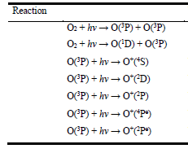
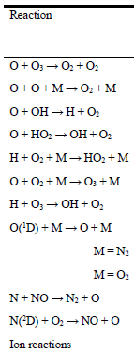
Other heating in the thermosphere
Chemical heating
FUV / EUV radiation leads to Photodissociation and Photoionisation of constituents like O2
Example shown is for O2 dissociation – which takes place in the Schumann-Runge bands and continuum and Lyman-alpha
Also O photoionisation to O+
Subsequent Recombination of products (eg O) is an exothermic reaction leading to chemical heating
In example shown (for lower thermosphere) O, H, N and ion recombination are most important heating reactions
Joule heating is frictional heating largely associated with electric currents in the thermosphere.
Auroral heating is due to energetic particle precipitation into high latitudes
Both generally quite minor in quiet times
But during geomagnetic storms can be dominant at high latitudes – increased particle precipitation and increased electric currents (leading to increased heating)
Notes:
Chris Kelly (Leeds) PhD thesis: p65 for table on left, p48 for table on top right

Slide 14
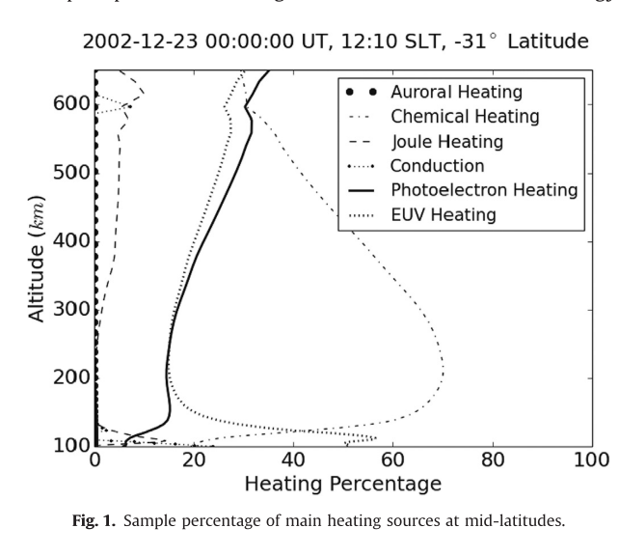
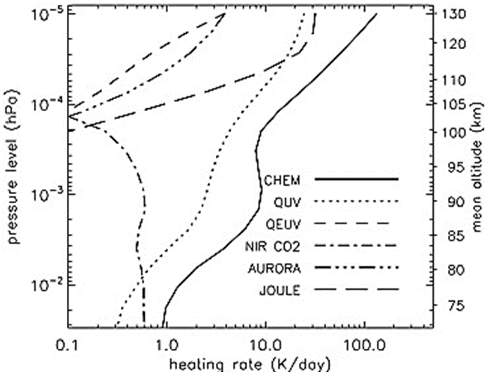
Energetics budget
Burrell et al 2015
Marsh et al 2007
Lower down, generally dominated by EUV heating
Higher up, chemical heating takes over
~representative of global picture - but actually spot value at middle latitudes, so don’t expect any Joule / auroral heating processes
Global mean July solar min for lower thermosphere
JH and auroral heating seen but will be higher at high lats
Exothermic heating important
Direct UV heating important at these heights; EUV role growing at higher altitudes
Notes:
Burrell et al 2015 https://doi.org/10.1016/j.jastp.2015.01.004. Photoelectron heating not in many models but in GITM. Formally, GITM defines the photoelectron heating as the difference between the total absorption and the ionization rates, multiplied by an efficiency term. Photoelectrons expend much of their energy during photoionization of neutral particles, though they also transfer heat through collisions with ambient electrons and neutral particles.

Slide 15

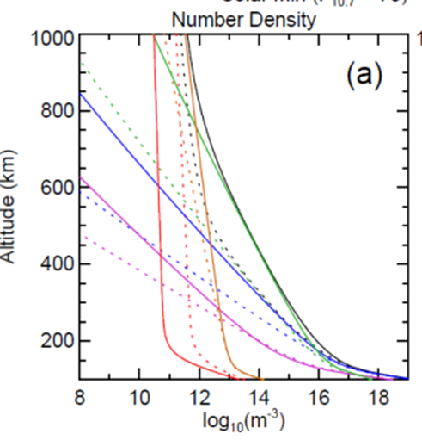
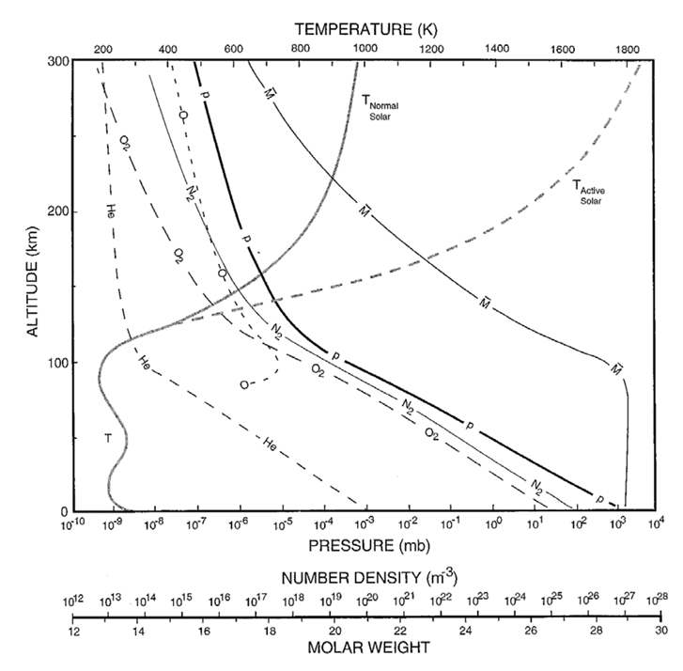
Homopause
Below homopause (~105 km) eddy diffusion (turbulent mixing) dominates
Above it, molecular diffusion – separation of constituents by particle mass
O dominates
Homopause
Note how composition changes significantly only at heights above ~100 km
Above ~180 km atomic oxygen is the major constituent
At 200-300 km O (lightest) dominates while O2 and N2 (heavier) fall off. Increased relative abundances of lighter elements (O, He, H) above around 550 km

Slide 16
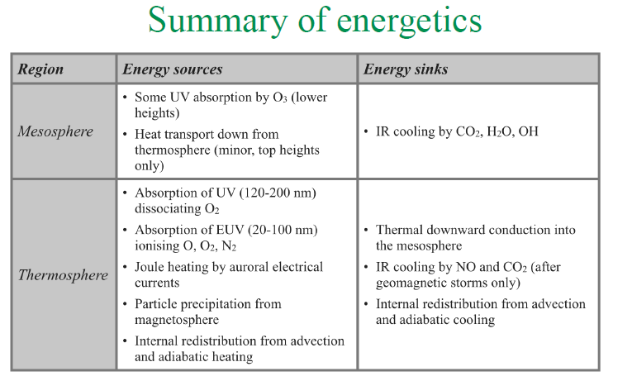
Coldest place on Earth
Hottest place in atmosphere
Notes:
Burrell et al 2015 https://doi.org/10.1016/j.jastp.2015.01.004

Slide 17
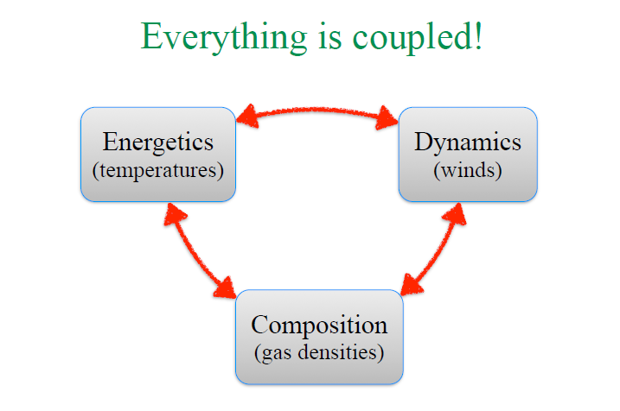

Slide 18
Part 1: Thermal structure
Questions?

