Slide 1
Part 3: Observations, Modelling and Forecasts

Slide 2
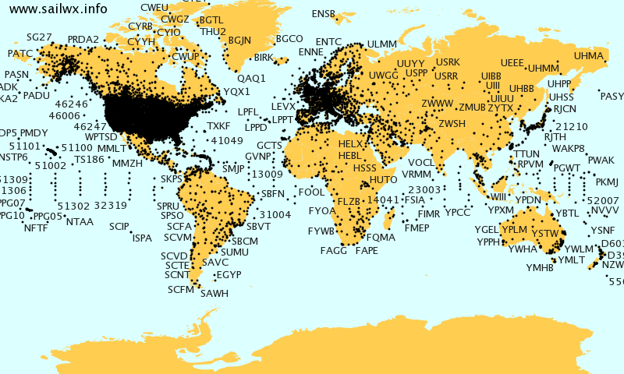
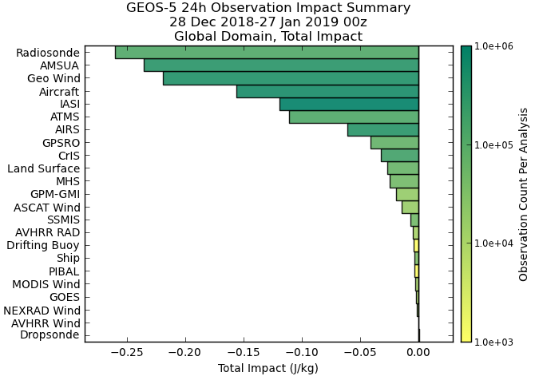
How do we study these regions?
Meteorological weather stations measuring P, T, U, humidity
Worth comparing with terrestrial weather Observations give key insights. Data assimilation (DA) of observations also helps models represent reality – lets models be used to provide skilful forecasts.
Many different types of observations help contribute to skilful weather forecasts
Weather balloons
Satellite instruments
Individual impact on a weather forecast from a given observation type (longer bar – more impact)
Terrestrial weather is fortunate: it benefits from lots of observations! Observing stations network coverage is impressive Global satellite coverage (not shown) even more so!
http://www.sailwx.info/wxobs/stationpick.phtml
NASA, 2019
Notes:
Over 800 meteorological weather stations around the globe, launching weather balloons up to the stratosphere, providing T, U, P, humidity. These can be data assimilated into models
https://en.wikipedia.org/wiki/Weather_balloon
About 800^{[4]} locations around the globe do routine releases, twice daily, usually at 0000 UTC and 1200 UTC.

Slide 3
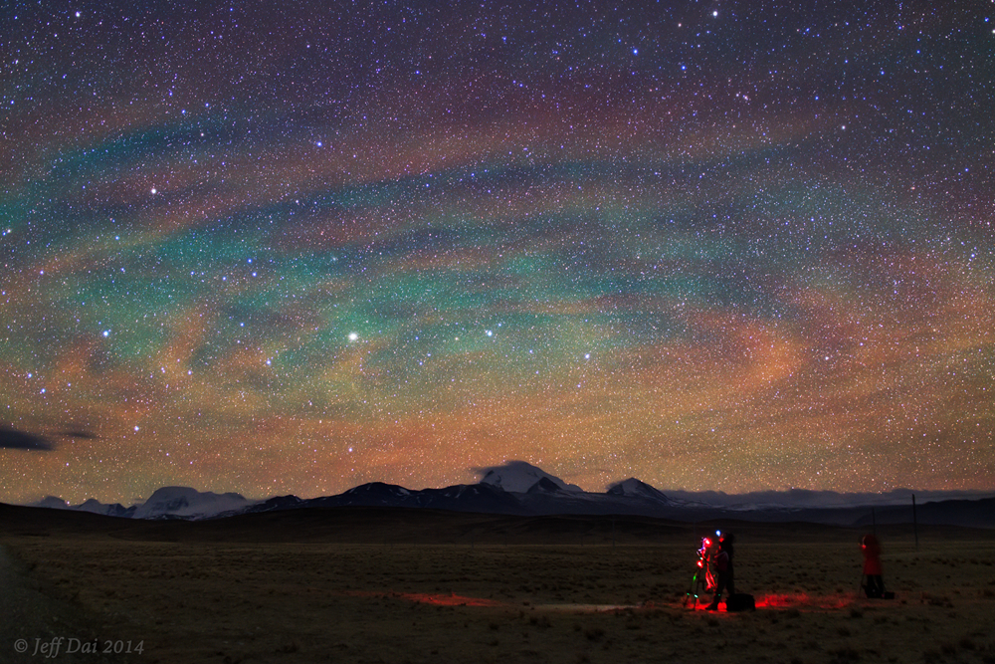
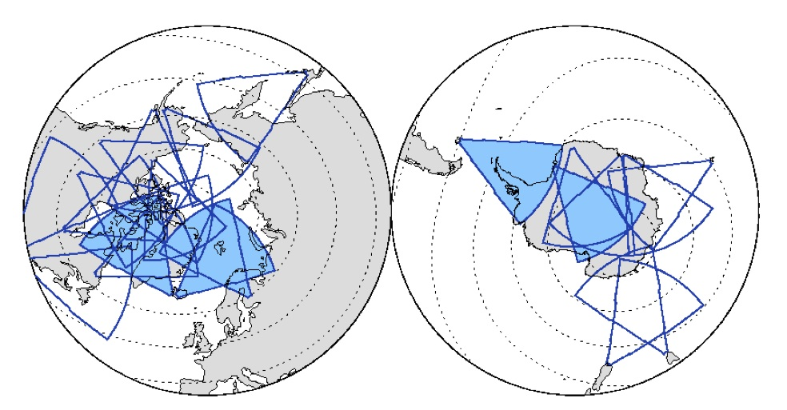
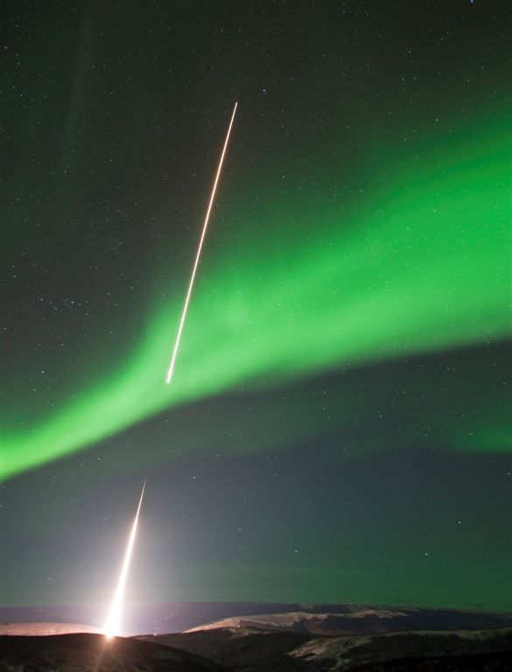
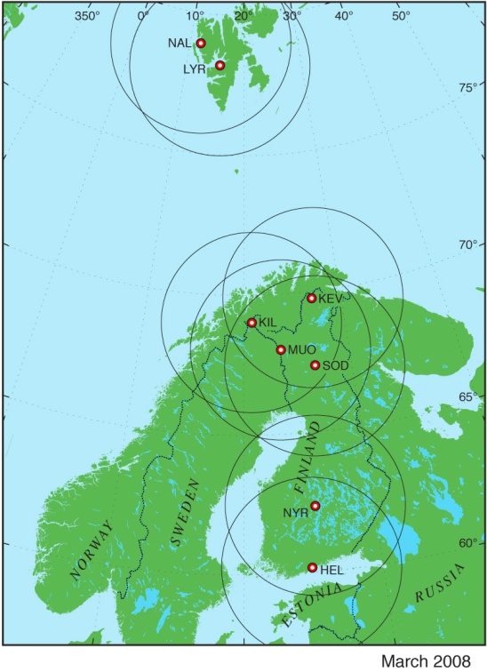
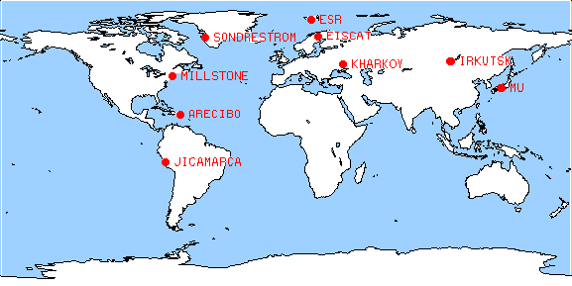
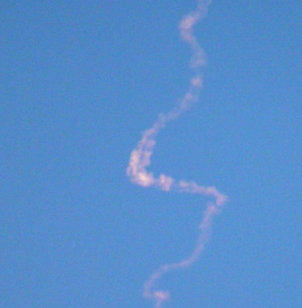
SuperDARN coherent scatter radar network
How do we study these regions?
Ground-based resources: radars, ionosondes, optical instruments, magnetometer networks, rocket launches (!)
Airglow: measure with Fabry-Perot interferometers
Poker flats rocket launch
MIRACLE all-sky camera network
Incoherent Scatter Radar network
FPIs
Infer winds from meteor trails
Far fewer ground-based resources for upper atmosphere-ionosphere monitoring
Notes:
In contrast, for upper atmosphere-ionosphere monitoring we have far fewer ground-based instrumentation.
Airglow is caused by various processes in the upper atmosphere of Earth, such as the recombination of atoms which were photoionized by the Sun during the day, (luminescence caused by cosmic rays striking the upper atmosphere, and chemiluminescence caused mainly by oxygen and nitrogen reacting with hydroxyl free radicals at heights of a few hundred kilometres)
There are plenty of magnetometers and magnetometer networks:
The expanded and upgraded Canadian Array for Realtime InvestigationS of Magnetic Activity (CARISMA) magnetometer array in the era of the THEMIS mission. Formerly operated as the Canadian Auroral Network for the OPEN Program Unified Study (CANOPUS)
SuperMAG
The MIRACLE network in Scandinavia has 7 all-sky cameras, and thanks to the THEMIS satellite mission there is good coverage of ASC over North America
The SuperDARN coherent radar network provides good coverage of the European and American sectors of the polar ionosphere, and of the Antarctic polar ionosphere. http://www.superdarn.ac.uk/what/
The STARE radar was closed in 2005 (http://www.space.fmi.fi/PLASMA/RADAR/STARE/index.html).
There are 9 ISR radars worldwide: EISCAT mainland and Svalbard radars, Sondrestrom, Millstone, Arecibo, Jicamarca, Kharkov, Irkutsk, and the Japanese MU radar. (http://www.haystack.mit.edu/atm/mho/iswg/index.html)
5 FPIs located on Greenland and Scandinavia, and 3 all-sky FPIs in Alaska, Svalbard and Antarctica.

Slide 4
Satellites
Some neutral remote sensing is possible: TIMED, GOLD, SABER, ICON, …
Other in-situ data: GOCE, CubeSats,…
But these research missions aren’t (yet) suited for operations
Data can’t be used like operational radiance products lower down, which are assimilated real-time to improve models, make forecasts
2019 Mar
Airbus DS, NASA's Scientific Visualization Studio/Tom Bridgman/Joy Ng
Notes:
The GOLD instrument is hoisted up and installed onto the SES-14 commercial communications satellite, which is being assembled at Airbus Defence and Space in Toulouse, France (image credit: Airbus DS)
https://directory.eoportal.org/web/eoportal/satellite-missions/g/gold
This is a visualization of data taken by the GOLD spectrometer aboard the SES-14 satellite. SES 14 is positioned in a geostationary orbit above 47.5º west longitude so it always observes the same hemisphere. This data is of ultraviolet emission from Earth's ionosphere in a band near the wavelength of 135.6 nm, an emission line of atomic oxygen (image credit: NASA's Scientific Visualization Studio/Tom Bridgman/Joy Ng)
https://gold.cs.ucf.edu/earths-shining-upper-atmosphere-from-the-apollo-era-to-the-present/
Miles Hatfield and Lina Tran—NASA’s Goddard Space Flight Center, Greenbelt, Md.
This picture highlights Earth’s ionosphere, a region of the upper atmosphere that is mostly invisible to our eyes — aside from aurora or airglow, if you’re in the right place at the right time — but shines in ultraviolet, or UV, wavelengths of light. Named for the electrically charged ions that move about freely there, the ionosphere absorbs UV light from the Sun and re-emits it to space.
The effect can be seen in this UV image. The Sun-facing side of Earth is bright. The rest of the planet, which is not receiving UV light from the Sun, remains dark, shrouded in night.
Attentive observers may notice [two] strips of UV emission that extend onto Earth’s night side. The two strips just above and below the equator are known as the Appleton Anomaly. They mark where Earth’s magnetic field interacts with the upper ionosphere to trigger dense fountains of uprising plasma.

Slide 5
Observational Needs for Thermospheric Forecasts
Observations of temperature, wind and density are required, ideally with
Resolution of 100-500 km (horizontal), 5-15 km (vertical, lower thermosphere), 20-100 km (vertical, upper thermosphere)
Observing cycle 5s-30 min and timeliness < 30-60 min
Far from the case right now!
Layer | Assessment | Comments
T (Hi Thermo) | Poor | Only a few sparse FPI observations are available. Poor timeliness.
T (Low Thermo) | Marginal | Optical Spectrograph and InfraRed Imaging System data are available, but they do not cover whole vertical range and have poor timeliness.
Density (Hi Thermo) | Marginal | Swarm meets most requirements, apart from timeliness and vertical resolution. SSUSI and SSULI may meet requirements, but no information is available on accuracy, observational cycle and timeliness
Density (Low Thermo) | < Marginal / Marginal | SSUSI and SSULI may meet requirements, but no information is available on accuracy, observational cycle and timeliness.
U (High Thermo) | Poor | Only a few sparse FPI observations. Poor timeliness. Accelerometer winds have too large errors to be useful. Region partially covered by new ICON observations.
U (Low Thermo) | Poor | Data gap (daytime) addressed by ICON. No other current observations.
Notes:
Top: Fig_CMAT2_dT120_june.pdf
Bottom: Fig_dtm2012_dT12-_june.pdf
From Sean Bruinsma for the ThermosRole NERC July 2013 application
Research models – slow
Operational models (Space Weather forecasting/satellite orbit prediction) - fast
Climate versus weather

Slide 6
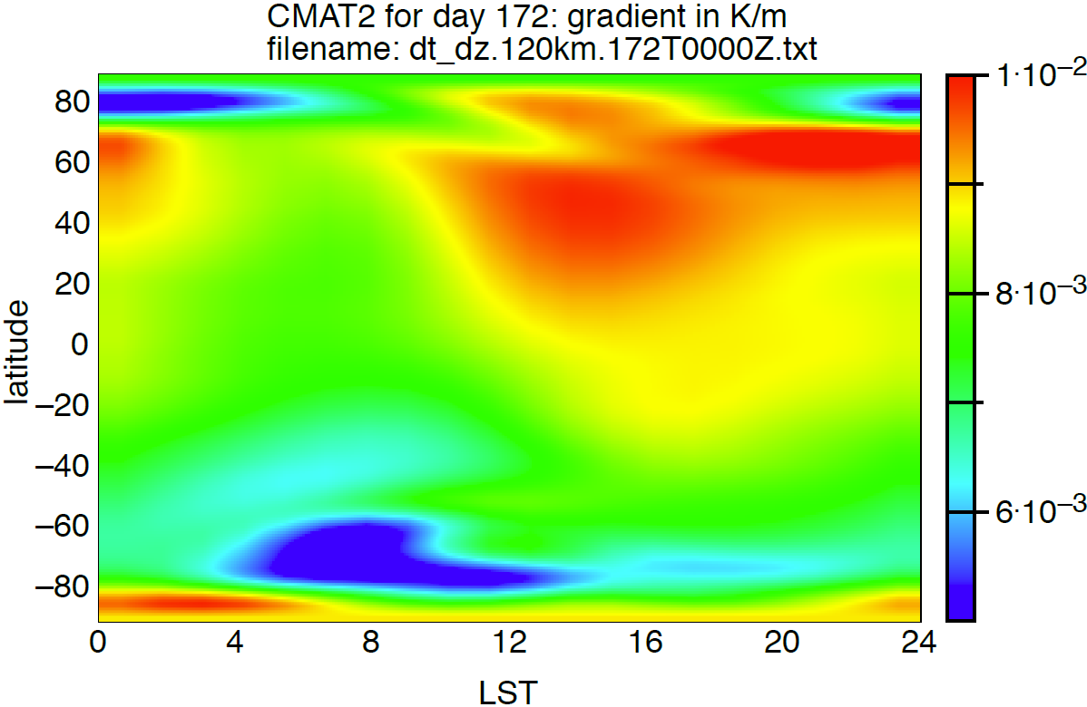
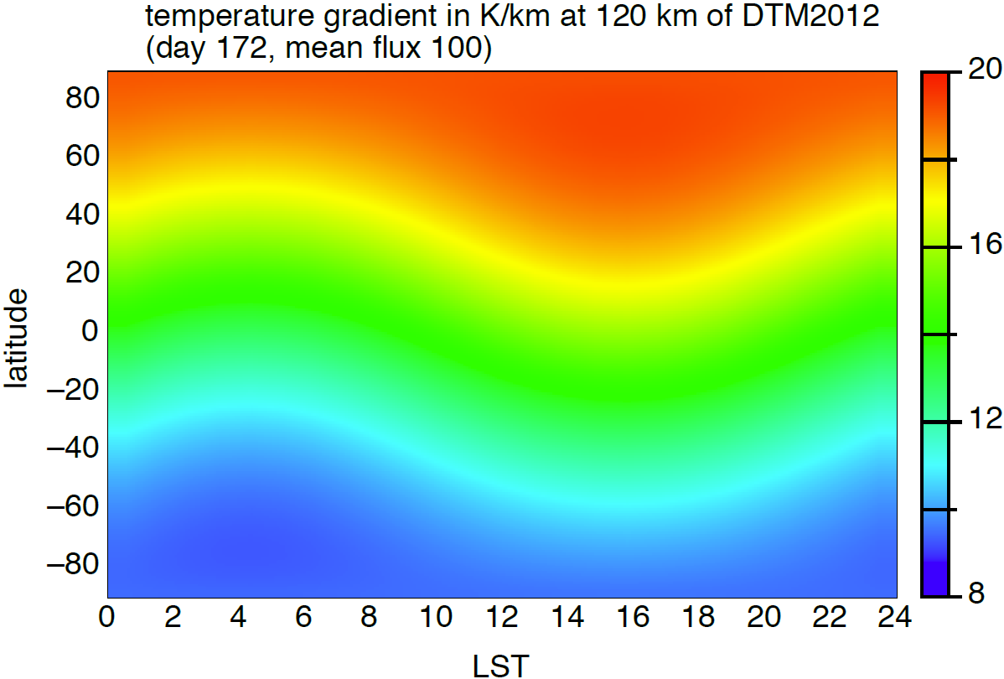
Thermospheric Models
UCL CMAT2 (day 172, mean flux 100) temperature gradient (K/km) at 120km
Semi Empirical (eg DTM, MSISE00): Trained on historical data, driven by solar and geomagnetic proxies. Often used in ops (eg Met Office). Low spatial resolution and poor for events not often seen in obs (eg Starlink)
1st principles (thermos/iono): T-I coupling (better evolution), lower boundary in stratosphere / mesosphere. Add in DA (TIEGCM AENeAS) for future MetO ops
1st principles (whole atmosphere): Comprehensive coupling from low to high. NOAA operational model (WAM) produced reasonable representation of Starlink event but limited DA currently
DTM2012 (day 172, mean flux 100) temperature gradient (K/km) at 120km
Chartier et al 2013
Notes:
Top: Fig_CMAT2_dT120_june.pdf
Bottom: Fig_dtm2012_dT12-_june.pdf
From Sean Bruinsma for the ThermosRole NERC July 2013 application
Research models – slow
Operational models (Space Weather forecasting/satellite orbit prediction) - fast
Climate versus weather

Slide 7
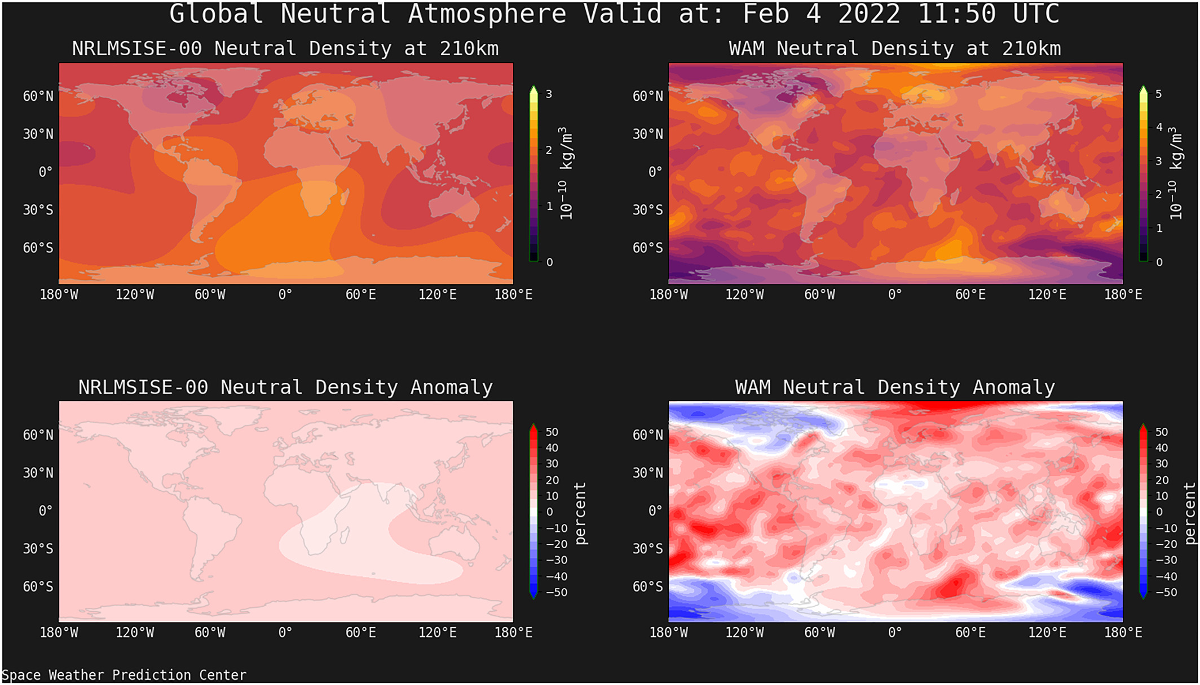
Thermospheric Models
Semi Empirical can be poor for geomagnetic storms compared to 1st principles models eg Starlink event
Global neutral density and density anomaly at 210 km simulated by MSIS-00 (left) and coupled WAM / IPE (right) at 11:50 UTC on 4 February 2022. Fang et al, 2023
Notes:
Top: Fig_CMAT2_dT120_june.pdf
Bottom: Fig_dtm2012_dT12-_june.pdf
From Sean Bruinsma for the ThermosRole NERC July 2013 application
Research models – slow
Operational models (Space Weather forecasting/satellite orbit prediction) - fast
Climate versus weather

Slide 8
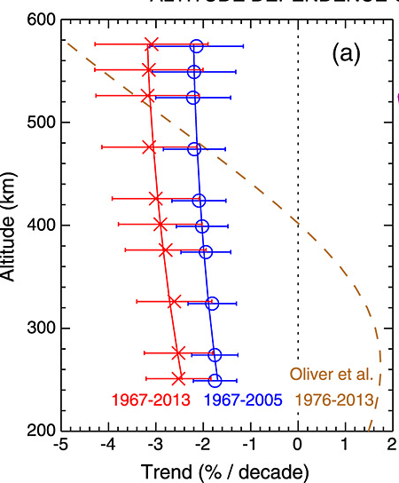
Thermospheric Climate Change
Impact of climate change seen as global warming in troposphere, but as cooling in strat / meso / thermosphere. => shrinking of thermosphere and a reduction in thermospheric density, due to contraction of the cooling atmosphere.
Lower thermosphere trend ~ -2 to -4 K/year and -3% /decade in density
At 400 km typical density trend ~ −2%/decade.
Can vary with solar cycle, altitude, latitude
If 1.5°C global warming target is met, objects in LEO will have orbital lifetimes ~ 30% > comparable objects from year 2000 (Brown et al, 2021)
Holmen et al 2016
Emmert 2016
Stober et al 2014
Notes:
Top: Fig_CMAT2_dT120_june.pdf
Bottom: Fig_dtm2012_dT12-_june.pdf
From Sean Bruinsma for the ThermosRole NERC July 2013 application
Research models – slow
Operational models (Space Weather forecasting/satellite orbit prediction) - fast
Climate versus weather

Slide 9
Further resources
Key texts treating the mesosphere/thermosphere regions:
Andrews, Holton and Leovy, Middle Atmosphere Dynamics, Academic Press, New York, 1987
Banks, P.M. & G. Kockarts, Aeronomy, Academic Press, New York, 1973
Brasseur, G and S. Solomon, Aeronomy of the Middle Atmosphere, D. Reidel Publishing, 2nd Edition, 1986
Chamberlain J. W., and D. M. Hunten, Theory of Planetary Atmospheres, Academic Press, New York, 1987
Chapman, S. C. and R. S. Lindzen, Atmospheric Tides, D. Reidel, Dordrecht, 1970
Fritts, D.C (1984) Gravity wave saturation in the middle atmosphere: A review of theory and observations, Rev. Geophys., 22, 275–308
Johnson, R. M. and T. L. Killeen (Eds), The Upper Mesophere and Lower Thermosphere: A Review of Experiment and Theory, American Geophysical Society, Geophysical Monograph 87, 1995
Rees, M. H., Physics and Chemistry of the Upper Atmosphere, Cambridge University Press, Cambridge, UK, 1989
Wang, W., Y. Zhang, Y., and L. J. Paxton (Eds), Upper Atmosphere Dynamics and Energetics, American Geophysical Union, Geophysical Monograph, 2021, DOI:10.1002/9781119815631
The MSIS empirical atmosphere model (surface to thermosphere) is available at NASA CCMC:
https://ccmc.gsfc.nasa.gov/modelweb/models/nrlmsise00.php

