Slide 1
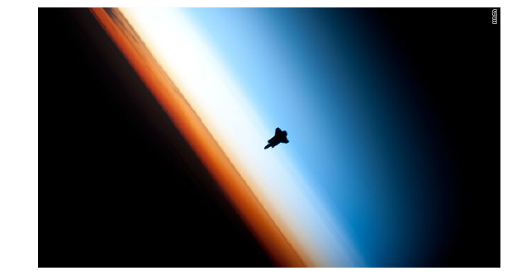
Part 2: Dynamics

Slide 2
Navier-Stokes equations represent fluid flow on a rotating sphere
Momentum, mass continuity, thermodynamics
Valid from surface to exobase
Core equation for a neutral fluid
(no charge, no magnetic materials)

Slide 3
Notes:
Forces are in order of magnitude

Slide 4
P = C
isobars
Notes:
Coriolis C always perpendicular to speed V
H high and L low pressure

Slide 5
P = C
isobars
Notes:
Coriolis C always perpendicular to speed V
H high and L low pressure

Slide 6
P = C
isobars
Notes:
Coriolis C always perpendicular to speed V
H high and L low pressure

Slide 7
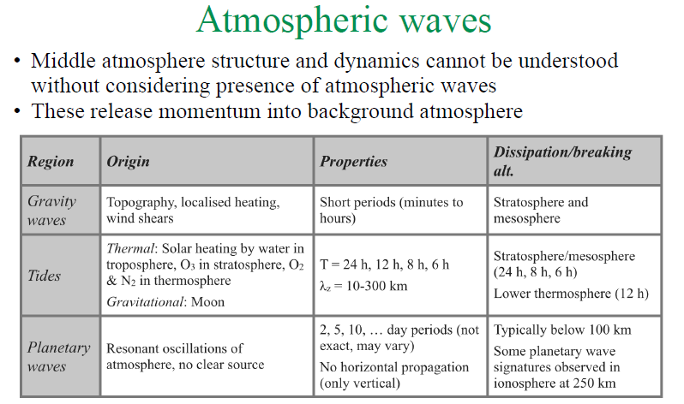
Type | Origin | Properties | Dissipation / breaking altitude
Planetary Waves | Forced (orography, low level heating) and free modes (resonant oscillations) | 2-30 day period Easterly / quasi-stationary Vertically propagating Global scale waveno 1-3 in strat / mesosphere | Typically < 100 km Some PW signatures seen in thermosphere
Gravity Waves | Orography, convection, fronts, etc | Period: minutes-hours Scale – typically 10-1000 km Easterly and westerly | Stratosphere and mesosphere (primary) Lower thermosphere (secondary)
Tides | Solar:Thermal heating (H2O in troposphere, O3 in stratosphere, O2 and N2 in thermosphere) Lunar: gravitational | 6,8,12,24 h | Stratosphere / mesosphere / lower thermosphere

Slide 8
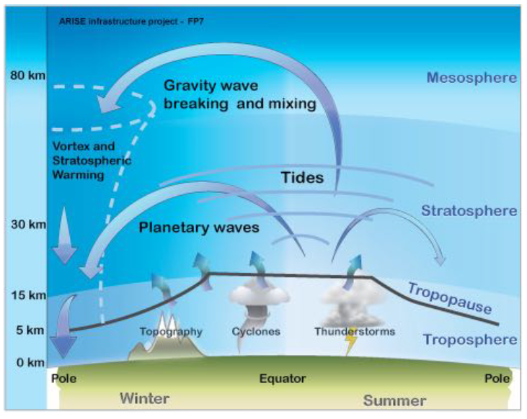
Atmospheric waves
Upward propagating waves break and dissipate, releasing energy and momentum
This provides a vertical coupling mechanism
Also responsible for structure in middle atmosphere
Notes:
Ask students what causes
AGWs – topography, localised heating, wind shears
Tides – solar heating by water (troposphere), ozone (stratosphere), O2 and N2 (thermosphere)
Planetary waves – no clear source of these resonant oscillations of the atmosphere

Slide 9
Gravity wave momentum deposition
Gravity wave grows as density decreases
Saturation reached when wave statically unstable, which also means u’+$\overline{u}$ > c (phase speed) at height $z_{s}$
Above 𝑧_{𝑠} u’ -> 0 and GW deposits momentum against mean flow until critical height $z_{c}$, where $\overline{u}−c = 0$ is reached
Also: waves absorbed at critical line where $\overline{u}=c$ so spectrum of eastward + westward waves travelling through westward wind shall be filtered so that only (largely) eastward waves remain
$$\left|u^{′}\right|$$
Fritts (1984)
Notes:
z_{s} saturation height and z_{c} critical height
z < z_{s} amplitude increases as atmospheric density decreases
z_{s} < z < z_{c} amplitude decreases as gw saturates. At z_{s} u+u’ > c (phase speed) because of surrounding wind c until u-c=0, when momentum is deposited into the atmosphere.
Note this cartoon ignores secondary gravity wave generation – see Fig 9 in https://progearthplanetsci.springeropen.com/track/pdf/10.1186/s40645-015-0059-0

Slide 10
Gravity waves: so what? Closure…
Winter hemisphere downwelling:
adiabatic heating
Net flow from GW drag
Breaking of gravity waves results in deceleration of mesospheric jets
Associated momentum deposition induces a pole-to-pole circulation in mesosphere with summer to winter flow and ascent (descent) over summer (winter) pole
Explains those cold summer temps!
Summer hemisphere upwelling: adiabatic cooling
Garcia & Solomon, 1983
Notes:
Momentum carried by the gravity wave is deposited into the mean flow and imposes a force on the flow of the background atmosphere – “wave drag”.
Momentum deposited by waves provides up to ~ 70% of the momentum of the flow in the MLT
The MLT has a wave-driven large-scale circulation.

Slide 11
Secondary gravity waves
Classical cartoon can make one assume gravity waves stop where they break in the mesosphere
Caution! There’s good observational evidence (radar data) for gravity wave influence further up
Basic mechanism seems to be generation in situ higher up – secondary gravity waves generated by intermittent breaking of primary waves near s/pause and associated instability
Tsuda et al 2015; Becker and Vadas 2018
Notes:
https://progearthplanetsci.springeropen.com/track/pdf/10.1186/s40645-015-0059-0.pdf

Slide 13
Day night T diffs are very large > 200 K in March; > 100 K at solstices
Solstice winter / summer differences > 400 K
Notes:
Winds flow perpendicular to isobars in upper thermosphere

Slide 14
Oberheide et al 2009
Akmaev et al 2008

Slide 15
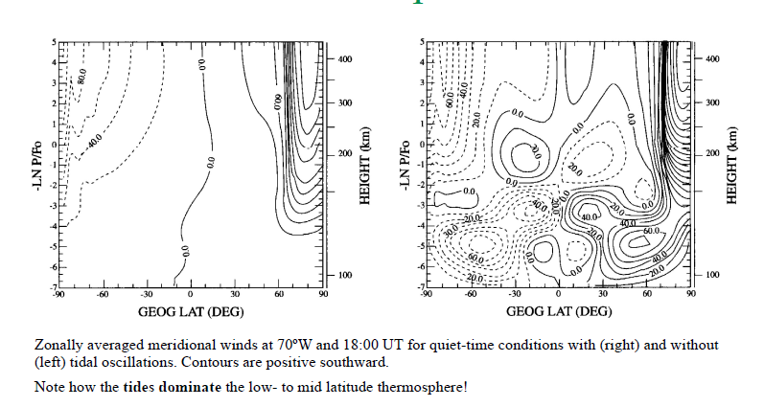
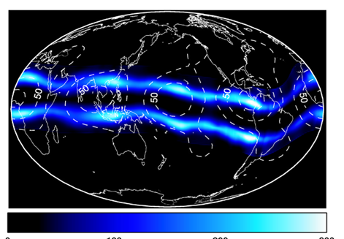
Effects of atmospheric tides
Lower atmosphere / lower thermosphere / ionosphere coupling
No tides
Including tides
W-4 structure (DE3 + (1,1) seen at 115 km (contours) and in ionosphere at ~300 km (contours) [Immel et al, 2006]
Momentum deposition from tides mainly from diurnal (<120 km) and semi-diurnal (>120 km)

Slide 16
Part 2: Dynamics
Questions?

